Slide 1
Ethical Hacking and Penetration Testing
Purva Singh | @purvasingh17

Slide 2
Agenda
Part - I
Part - II
Part - III
Part - IV
Web Penetration Testing
Wireless Penetration Testing
Quiz
Core Concepts of Ethical Hacking
Ethical hacking and ethical hackers.
Phases of ethical hacking.
Case study
OWASP Top-10
Injection Attacks
Broken Authentication
Deauthentication frames
Evil prone access point
Automated wifi hacking using Fluxion
Fluxion- Behind the scenes
Short quiz on ethical hacking and penetration testing

Slide 3
Practice Website
https://w-cs.000webhostapp.com/bWAPP_latest/bWAPP/login.php
(http://bit.ly/ghci-bwapp)

Slide 4
Part - I
Ethical Hacking

Slide 5
Ethical Hacking and Ethical Hackers
What is Ethical Hacking?
Ethical hacking, also known as penetration testing, involves same tools, tricks and techniques that hackers use.
Ethical hacking is legal.
Who are Ethical Hackers?
Ethical hackers are independent security professionals break into computer systems.
Neither damage target systems or steal sensitive information.
Evaluate target system’s security and report back to owners with bugs found.

Slide 6
5 phases of Ethical Hacking
Phase- 1
Reconnaissance
Phase- 2
Scanning
Phase- 3
Gain Access
Phase- 4
Maintain Access
Phase- 5
Clear Tracks
Information gathering about target.
Reconnaissance comprises of 2 phases -
Dumpster Diving
Footprinting
Scanning target for vulnerabilities.
There are 2 types of scanning-
Active Scanning
Nmap
Passive Scanning
GHDB
Shodan
Vulnerability exploitation and attempt to hack into the target system.
Backdoor installation by hackers to access system again in future.
Deletion of logs of activities that took place during hacking.

Slide 7
Part - II
Web Penetration Testing

Slide 8
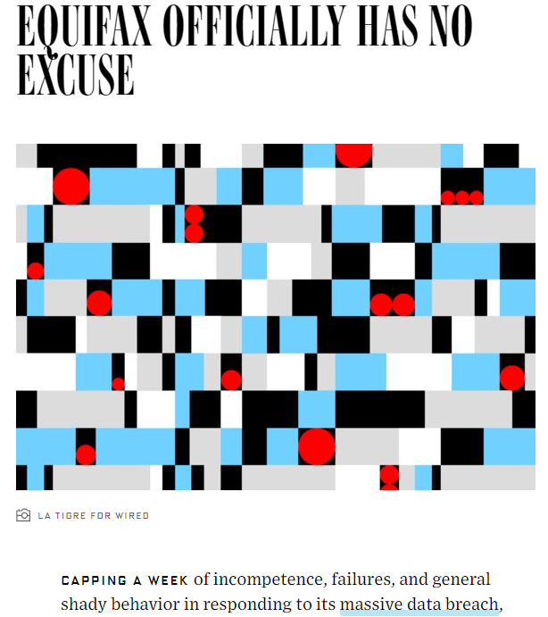
Case Study - Equifax
EQUIFAX Encountered with a massive data breach for a bug that was about to be patched.
Around 143 Million customer details were leaked.

Slide 9
OWASP
(Open Web Application Security Project)
An organization that provides unbiased and practical, cost-effective information about computer and Internet applications.
The goal of OWASP TOP 10 is to educate developers, organizations and designers about the consequences of the most common and most important web application security weakness
Every year they release reports on top 10 most critical web application security risks.

Slide 10
OWASP Top 10 Report for 2019
A1 - Injection
A2 - Broken Authentication
A3 - Sensitive Data Exposure
A4 - XML External Entities (XXE)
A5 - Broken Access Control
A6 - Security Misconfiguration
A7 - Cross-Site Scripting (XSS)
A8 - Insecure Deserialization
A9 - Using Components with Known Vulnerabilities
A10 - Insufficient Logging & Monitoring
Notes:
Add color coded stuff

Slide 11
A1 - Injection Attacks

Slide 12
A1 - Injection
Command (Code)
Command (Command)
Instead of code, command is passed as data
Interpreter
Interpreter
Run the program
Run the program

Slide 13
A1 - Injection
The most important property violated here is:
Access Control
Data is leaked to people without any access. Access should only be given to system administrators.
Untrusted data is sent to an interpreter as part of a command or query.
Trick the interpreter into executing unintended commands or accessing data.

Slide 14
A1 - Injection
Following are some common types of injection attacks :-
SQL Injection
OS Command Injection
XSS Injection

Slide 15
SQL Injection Attack

Slide 16








SQL Injection
An SQL query is one way through which an application talks to database.
An SQL injection occurs when there is lack of proper data validation
An attacker can use specially-crafted SQL commands to trick application into asking database to execute unexpected commands

Slide 17
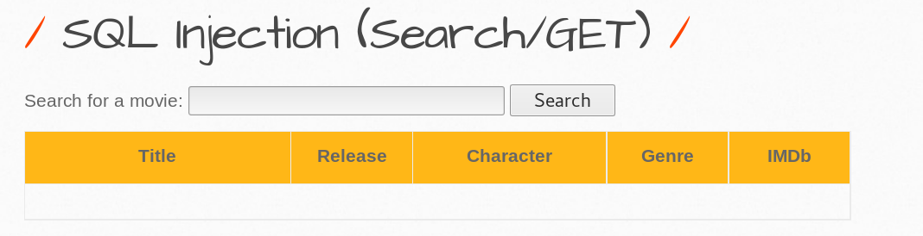
SQL Injection
Makes it possible to execute malicious SQL statements.
Hackers may use it to gain unauthorized access to your sensitive data: customer information, personal data, trade secrets, intellectual property, and more.
Below is a sample application to search for movies -

Slide 18
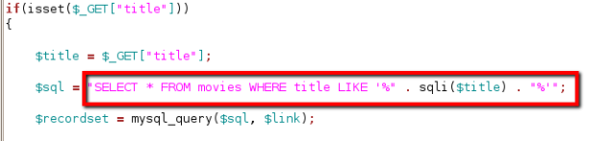
SQL Injection
Query running in the back-end is as follows -

Slide 19
SQL Injection
ORIGINAL QUERY
SELECT * FROM movies WHERE title LIKE ‘%” . sqli($title) . “%’”
MODIFIED QUERY BY ADDING ‘ IN THE TEXT BOX
SELECT * FROM movies WHERE title LIKE ‘%” .’
Query Incomplete
Display Error Message

Slide 20
SQL Injection
ORIGINAL QUERY
SELECT * FROM movies WHERE title LIKE ‘%” . sqli($title) . “%’”
MODIFIED QUERY BY ADDING ‘ ‘ IN THE TEXT BOX
SELECT * FROM movies WHERE title LIKE ‘%” . ‘’ . “%’”
Query complete with no inputs
Display all records

Slide 21
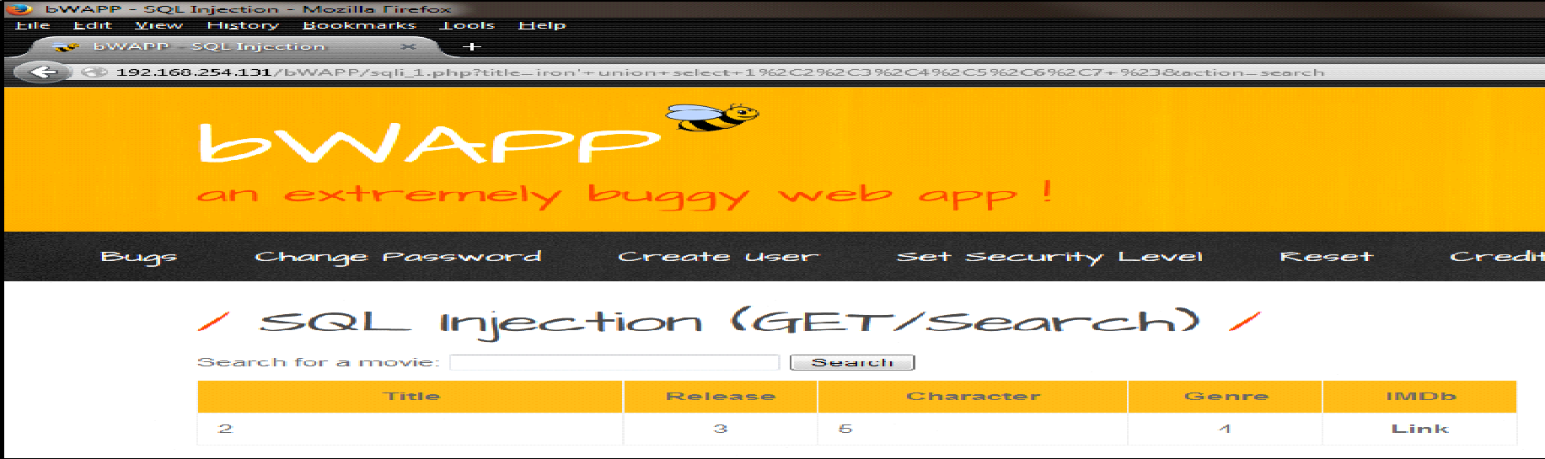
SQL Injection
Query insertion to check the data is entered into which column:
Query: ghci’ union select 1,2,3,4,5,6,7 #

Slide 22
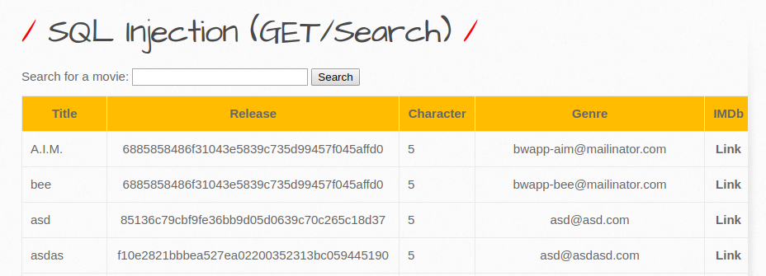
SQL Injection
Extract login credentials
Query: ghci’ union select 1,login,password,email,5,6,7 from users #

Slide 23
SQL Injection
(Mitigations)
Prevention from SQL injection attacks-
Proper input validation and parameterized queries including prepared statements.
Application code should never use the input directly.
Must remove potential malicious code elements such as single quotes.
Turn off the visibility of database errors on your production sites.

Slide 24
OS Command Injection Attack

Slide 25
OS Command Injection
An Operating System (OS) command injection attack occurs when an attacker attempts to execute system level commands through a vulnerable web application.

Slide 26
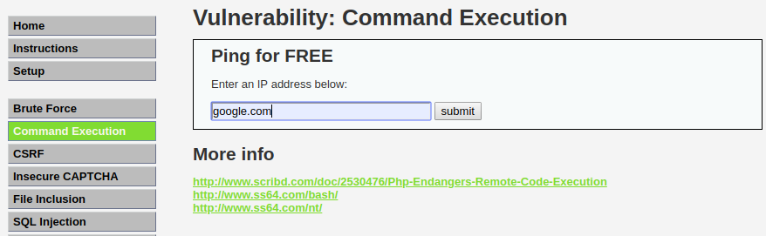
OS Command Injection
Makes it possible to execute malicious OS commands.
Below is a sample website that pings any host on IP network

Slide 27
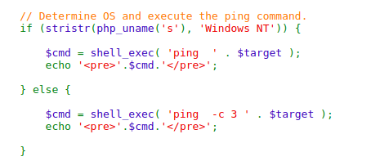
OS Command Injection
Back-end of application vulnerable to OS command injection is analogous to -

Slide 28
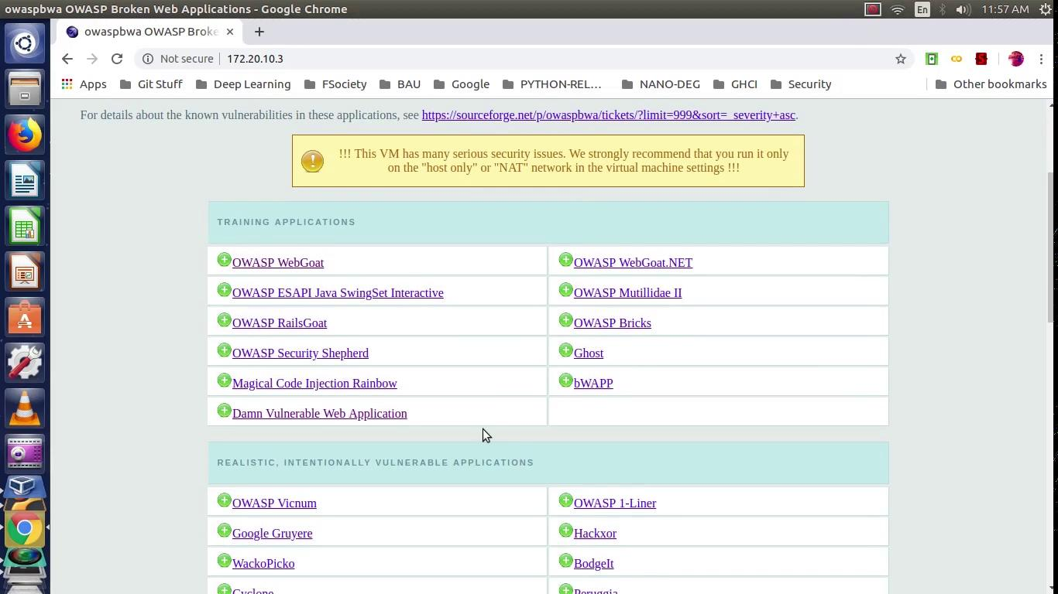
OS Command Injection

Slide 29
OS Command Injection
(Mitigations)
Prevention from OS command injection attacks-
Developer should use existing API for their language.
(Java): Rather than use Runtime.exec() to issue a ‘mail’ command, use the available Java API located at javax.mail.*
If no such available API exists, the developer should scrub all input for malicious characters.
It is much easier to define the legal characters than the illegal characters.

Slide 30
Cross-Site Scripting

Slide 31
HTML
Hypertext Markup Language is the standard markup language for creating web pages and web applications.
Building blocks of HTML pages
Represented by tags
HTML tags label pieces of content such as "heading", "paragraph", "table", and so on
Browsers do not display the HTML tags, but use them to render the content of the page

Slide 32
HTML
<b>Hello</b>
<i>Hello</i>
<u>Hello</u>
Hello
Hello
Hello
Tags are used to specify contents and styles in website. There are different types tags used to specify contents such as <h1> to <h6> for headings, <p> for paragraphs. Different types of tags used to specify styles are <b> to make the text bold, <i> to make the text italics and <u> to make the text underlined.

Slide 33
HTML <script> tag
The <script> tag is used to define a client-side script (JavaScript).
The <script> element either contains scripting statements, or it points to an external script file through the src attribute.
Common uses for JavaScript are image manipulation, form validation, and dynamic changes of content.
<script>JavaScript Commands</script>
Harmless XSS
Example:
(Changes HTML content)
<script>document.getElementById("demo").style.fontSize = "25px";</script>
Harmful XSS
Example:
(Steals SIDs, cookies etc)
<script>alert(document.cookie)
</script>

Slide 34
Cross-Site Scripting - Overview
Cross-site Scripting (XSS) is a client-side code injection attack where attacker aims to execute malicious scripts in a web browser of the victim by including malicious code web application.
There are 2 stages to a typical XSS attack -
An attacker must first find a way to inject malicious code (payload) into a web page that the victim visits.
Victim must visit the web page with the malicious code. Targeted victims can be attacked by sending them malicious URL.

Slide 35
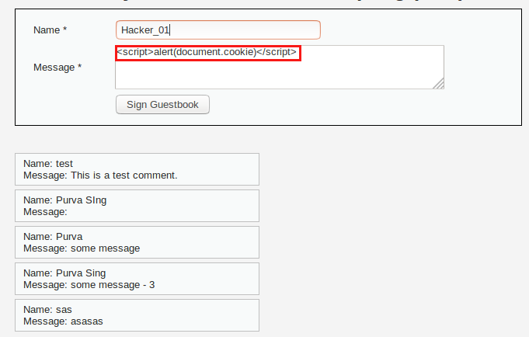
Cross-Site Scripting - Scenario
Attacker injects payload into the website’s database by submitting a vulnerable form with malicious JavaScript content.

Slide 36
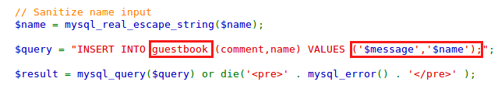
Cross-Site Scripting - Scenario
Website’s database gets infected since non-validated malicious JavaScript code gets inserted in the ‘guestbook’ table

Slide 37
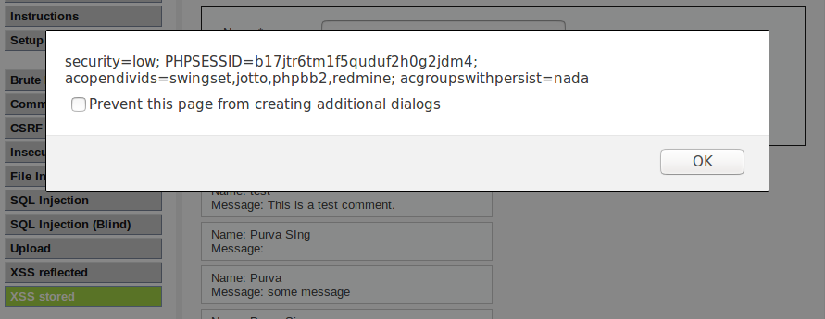
Cross-Site Scripting - Scenario
The victim requests the web page from the web server. The web server serves the victim’s browser the page with attacker’s payload as part of the HTML body.
The victim’s browser executes the malicious script contained in the HTML body. In this case, it sends the victim’s cookie to the attacker’s server.

Slide 38
Types of XSS
There are 3 types of XSS -
Reflected XSS
Stored XSS
DOM XSS

Slide 39
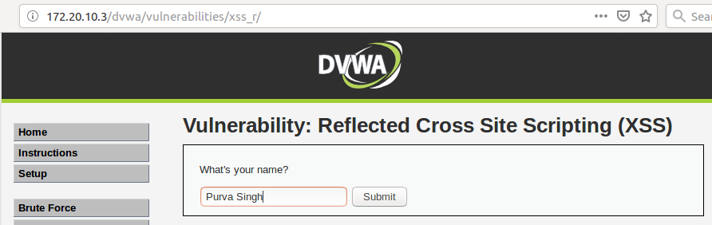
Reflected XSS - Scenario
User enters her name in the text-box of an insecure web-app that receives data is vulnerable to XSS attack.

Slide 40
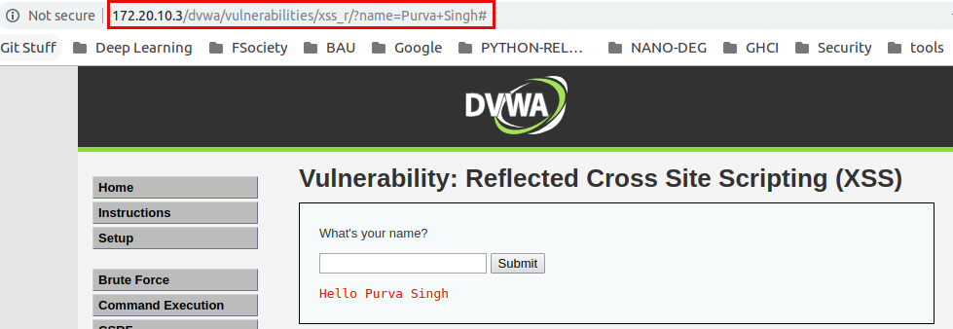
Reflected XSS - Scenario
The insecure web-application receives data in an HTTP request (query parameters) and includes that data within the immediate response in an unsafe way.

Slide 41
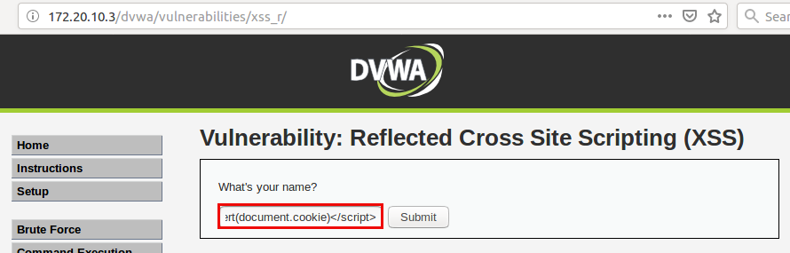
Reflected XSS - Scenario
Attacker passes malicious JavaScript command to steal victim’s cookie containing passwords and other sensitive information.

Slide 42
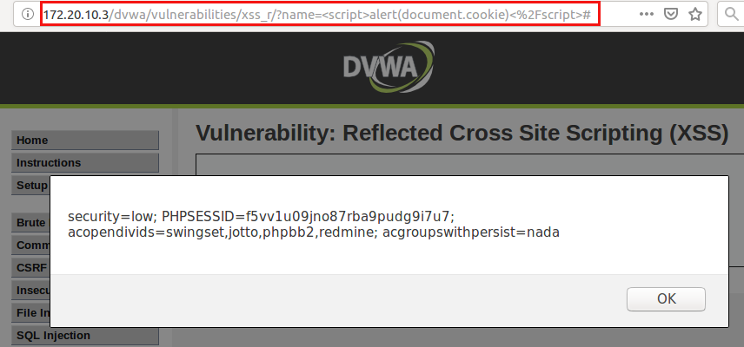
Reflected XSS - Scenario
New malicious URL gets formed that can capture cookie of victim. When victim is redirected to this malicious URL, her cookie is retrived by her attacker.

Slide 43



Reflected XSS - Summary
2) User clicks the link and it is executed in browser
3) Browser sends private data to attacker
1) Attacker sends malicious link to user
User
Attacker

Slide 44
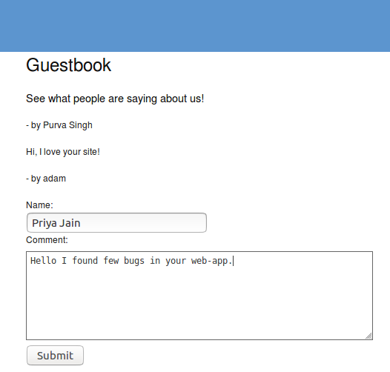
Stored XSS - Scenario
User signs-up in an insecure GuestBook web-app so that she can post her message online

Slide 45
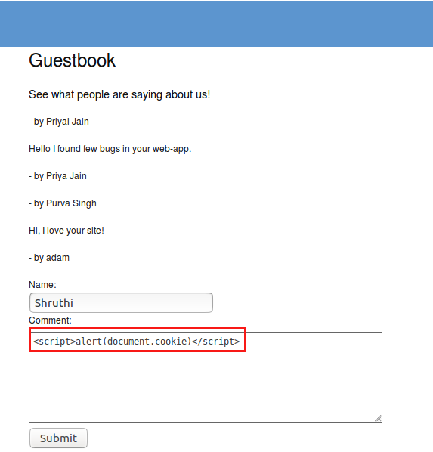
Stored XSS - Scenario
Attacker injects malicious JavaScript code to retrieve cookie of any victim who visits the infected web-app.

Slide 46
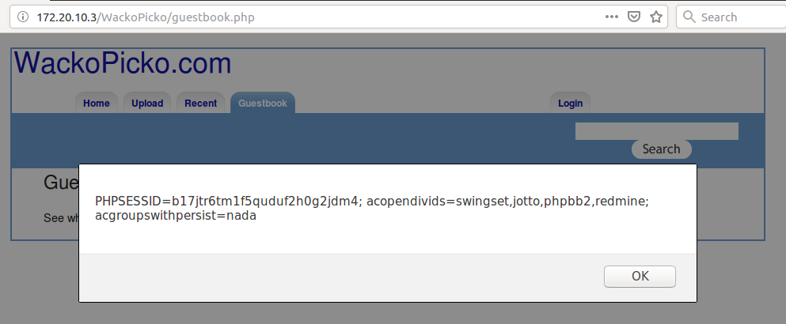
Stored XSS - Scenario
Everytime any victim visits the infected page, malicious JavaScript code is activated and their cookie gets sent to attacker

Slide 47
Stored XSS - Summary
2) For each visit to website, malicious script is activated
1) Attacker injects website with malicious script
3) Visitor’s session cookie is sent to attacker
Website visitor
Attacker

Slide 48
Cross-Site Scripting
(Mitigations)
Escaping :
Escaping data means taking the data an application has received and ensuring it’s secure before rendering it for the end user. For example, a < symbol may be converted to &lt;
Validation Input:
Validating input is the process of ensuring an application is rendering the correct data and preventing malicious data from doing harm to the site, database, and users.
Whitelisting only allows good character to be entered.
Sanitizing
A third way to prevent cross-site scripting attacks is to sanitize user input.
Sanitizing user input is especially helpful on sites that allow HTML markup, to ensure data received can do no harm to users as well as your database by scrubbing the data clean of potentially harmful markup, changing unacceptable user input to an acceptable format.

Slide 49
A2- Broken Authentication

Slide 50
A2 - Broken Authentication
Following weaknesses can allow an attacker to either capture or bypass the authentication methods that are used by a web application -
Unencrypted authentication credentials
Predictable credentials
Exposed session IDs (SIDs) in URL
SID is not random enough
Broken authentication vulnerability is susceptible to -
Brute-force login attacks
Dictionary attacks

Slide 51
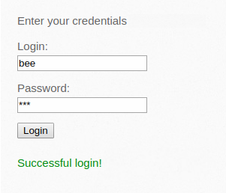
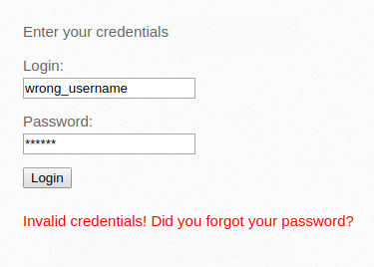
A2 - Broken Authentication
(Brute-force Attack)
Below is an example of Brute-force attack to hack into login pages containing weak passwords-

Slide 52
A2 - Broken Authentication
(Dictionary Attack)
User tends to keep passwords simple and easy to guess.
In absence of proper input sanitation, user is allowed to keep weak/common password.
There are multiple dictionaries available that contains list of common passwords.
Attacker can use such dictionaries along with automated tools e.g. BurpSuite to guess the user password.

Slide 53
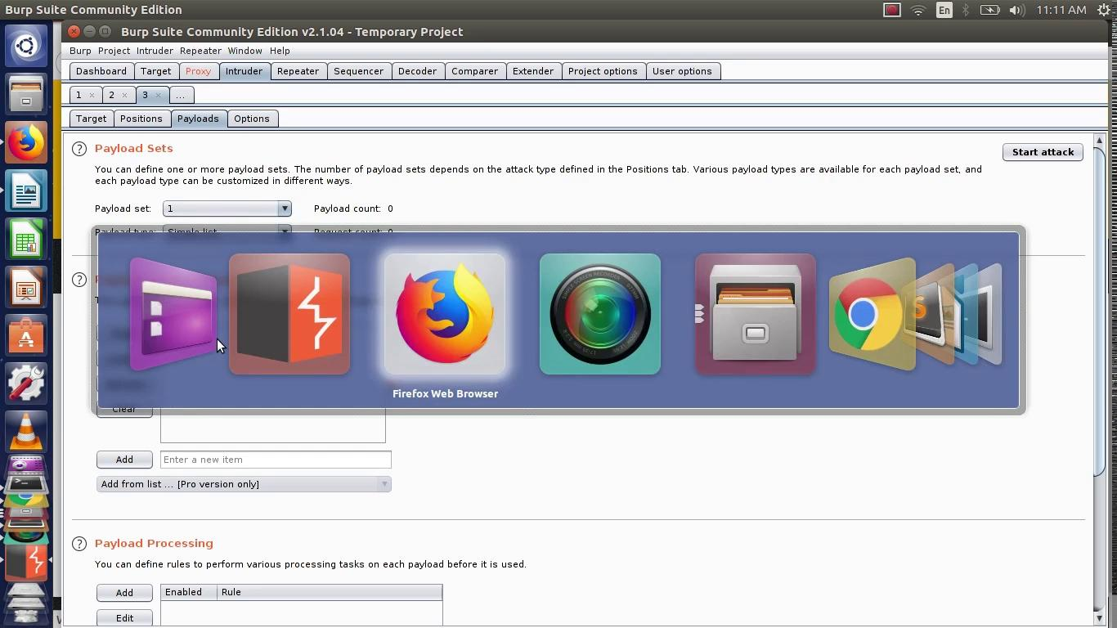
A2 - Broken Authentication
(Dictionary Attack)

Slide 54
A2 - Broken Authentication
(Mitigations)
Increase password complexity requirements
Set up password expiration for users’ accounts.
Temporarily blocking an IP that originated a high number of authentication errors in a brief period.
All the default passwords should be changed of the application before going live.

Slide 55
Part - III
Wireless Penetration Testing

Slide 56


Connecting to WiFi Network @ Home -
Behind the Scenes
1.) Set-up your wireless router.
2.) Check your device if it has wireless adapter (monitor mode only).
Most internet-enabled devices today come with a wireless adaptor built in.
Older computers/VMs require a plug-in adaptor in order to get online wirelessly

Slide 57
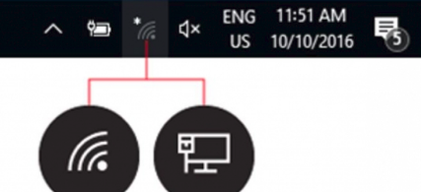

Connecting to WiFi Network @ Home -
Behind the Scenes
3.) If there is a wifi adaptor, a wifi icon should also appear in the system tray
Windows - 10
Linux

Slide 58
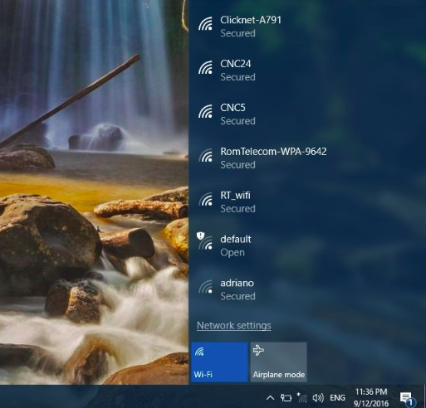
Connecting to WiFi Network @ Home -
Behind the Scenes
4.) Click on the WiFi icon to monitor and connect to wireless network

Slide 59
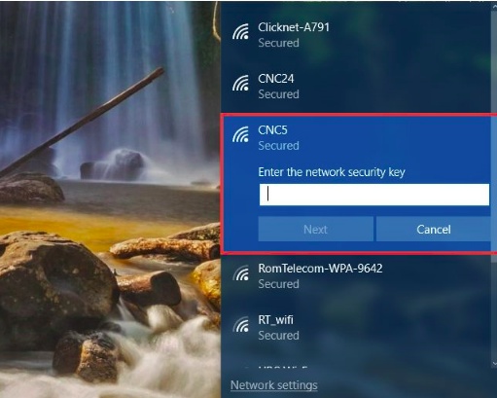
Connecting to WiFi Network @ Home -
4 -way Handshake
4.) Enter the security key (password) to authenticate yourself and connect to wireless network.
This is where 4-way handshake comes into picture.

Slide 60
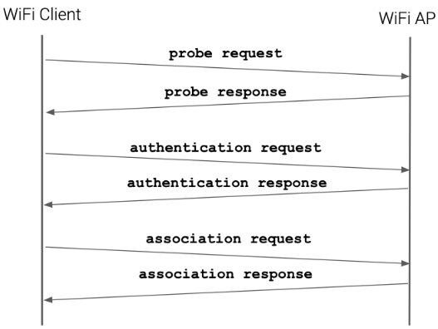
Wifi Hacking via
Evil Prone Access Point
Wi-Fi deauthentication attack is a type of attack where the attacker sniffs away 4-way handshake by disconnecting clients from WAP
Frames sent from one station aimed to terminate connection from target station by spoofing MAC address of all clients.
Evil prone access point recreates already existing WAP and forces clients to connect to evil-twin access point to capture network protocol.
Then it sends de-authentication frames to clients to break connection re-directs them towards the malicious WAP.

Slide 61
Automating Wifi Hacking via
Fluxion
Fluxion is a new program that provides an automated way to trick users into giving up their log-in and password information.
It sniffs the 4-way handshake to affect the functionality of a login page as it attempts to gain receipt of user information
It often requests that the user allow time for their router or firmware to reload or be updated while the real objective is to steal sensitive information.

Slide 62
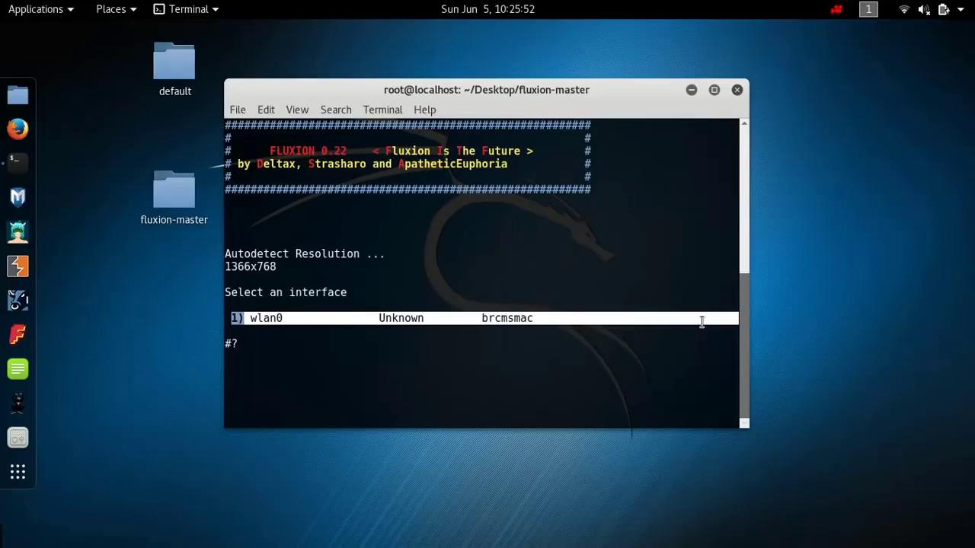
Fluxion- Behind the Scenes

Slide 63
Password Cracking using Crunch
Kali linux comes with pre-installed word-lists that could be used for brute-force attack to capture password.
But, in cases where attacker knows victim, the attacker might want to create her own set of password list, which would fasten the brute-force process.
Crunch creates word-list based on criteria/reg-ex that attacker specifies.
Output from crunch can be send to screen, file or other program.
Crunch example-
Crunch command - crunch 4 7 @%word
Sample password– e#word

Slide 64
Quiz
https://tinyurl.com/quiz-ghc-ethical-hacking

